Slide 1
Capita Selecta: AI
DeepProbLog approach to classify Rock Paper Scissors Lizard Spock
Aytug Altin

Slide 2



The plan

Slide 3


The plan

Slide 4
Why did I do this
Incorporating logical predicates useful?
Are we making neural nets smarter?
Faster? How much faster?
Scalable? How much more scalable?
Personal interest
Challenge
Novel technique

Slide 5
Implementation
Cross-entropy loss
The network architecture: 2 convolutional layers ,followed by 3 linear layers 120, 84 and 3
The learning rate 0.0001.
Adam optimization for neural networks, SGD for logic parameters

Slide 6
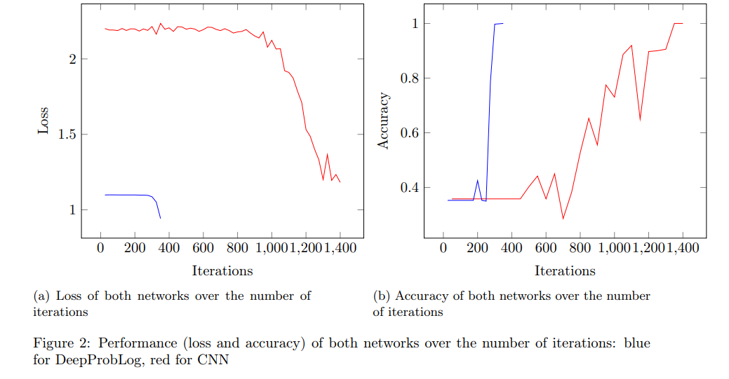
Results: RPS

Slide 7
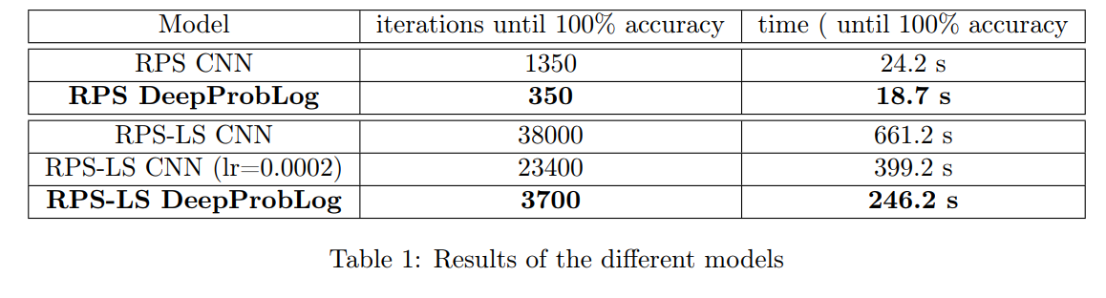
Results: RPS

Slide 8
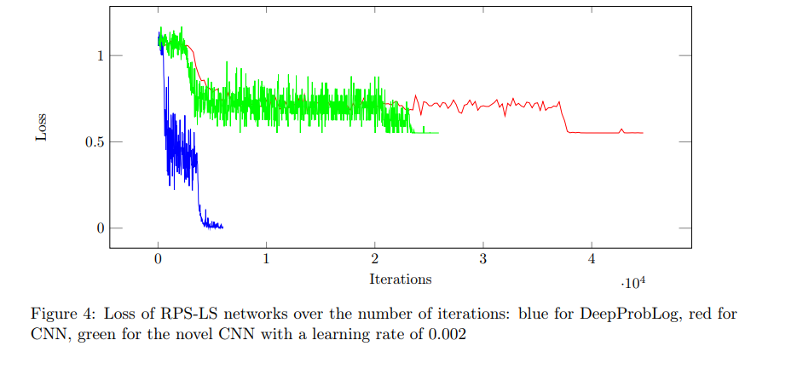
Results: RPS+LS

Slide 9
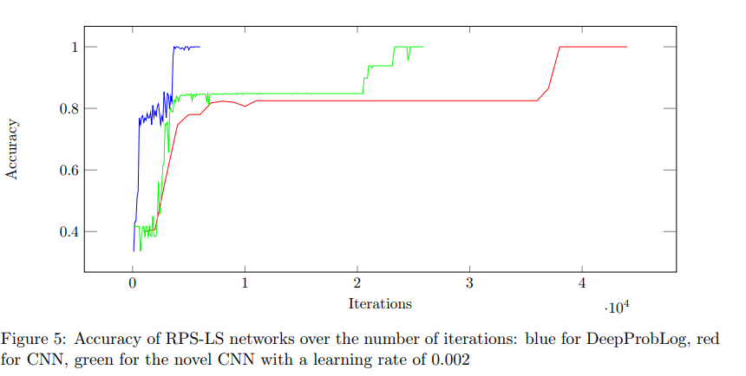
Results: RPS+LS

Slide 10
Results

Slide 11
Conclusion
Relatively easier to scale
Better performance
Incorporating logic is promising

Slide 12
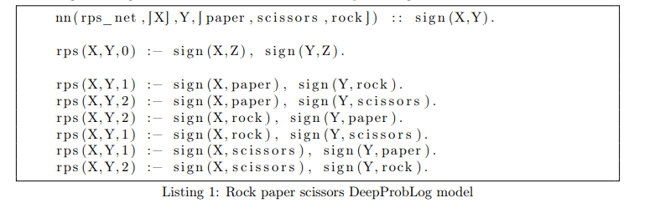

Slide 13
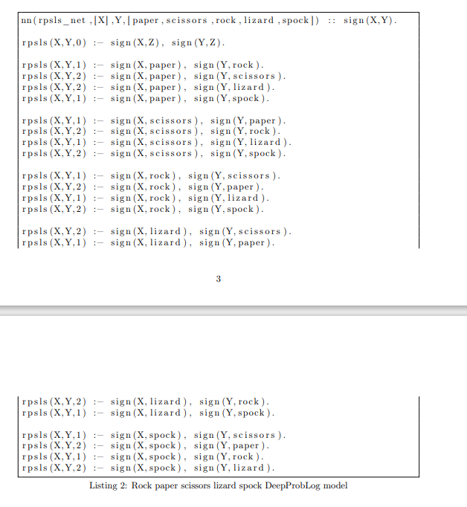

Slide 14
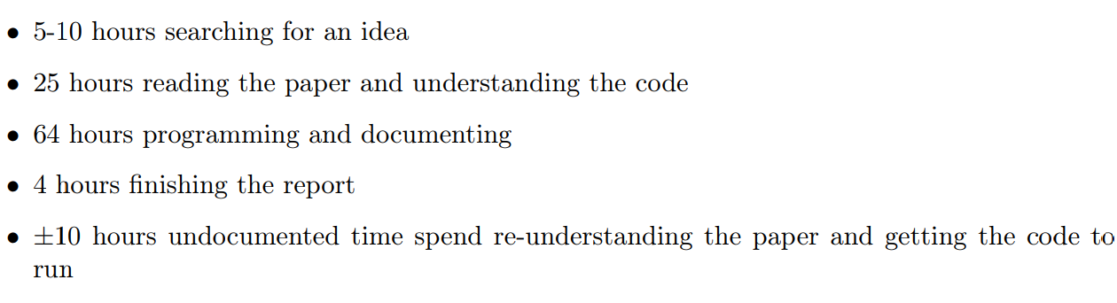
Time spend

Slide 15
